Slide 1
Substitution models & discrete character evolution

Slide 2
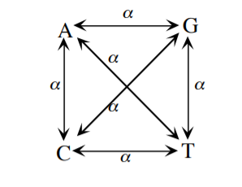
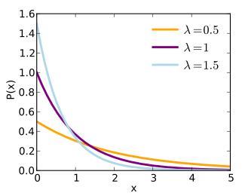
Poisson Process
Expected number of events ~ Poisson (λt)
Interinterval time ~ Exponential (λ)
Mean = 1/λ
Jukes Cantor (JC69)

Slide 3
Back to biology - Are JC69's assumptions realistic?
Assumptions of JC69:
1. All substitutions equally likely
2. Base frequencies equal
3. Every site has equal probability of substitution
4. Process is constant through time
5. Sites are independent of each other
6. Substitution is Markovian (memoryless)
7. All sites have the same evolutionary history
Can we relax any of these assumptions?

Slide 4
Can we relax any of these assumptions?
1. All substitutions equally likely
Add more parameters to Q matrix
2. Base frequencies equal
Allow for unequal state frequencies
3. Every site has equal probability of substitution
Different Q matrices for different sites
4. Process is constant through time
Different Q matrices for different branches/epochs
5. Sites are independent of each other
...it's complicated...
6. Substitution is Markovian (memoryless)
...it's very complicated...
7. All sites have the same evolutionary history
Coalescent theory

Slide 5
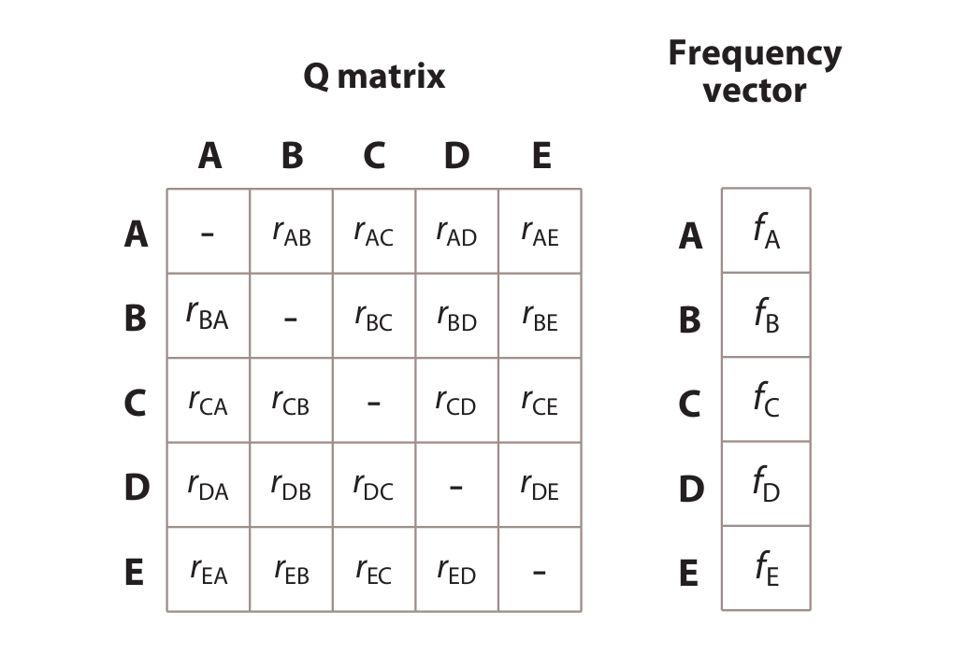
Our general CTMP model:

Slide 6
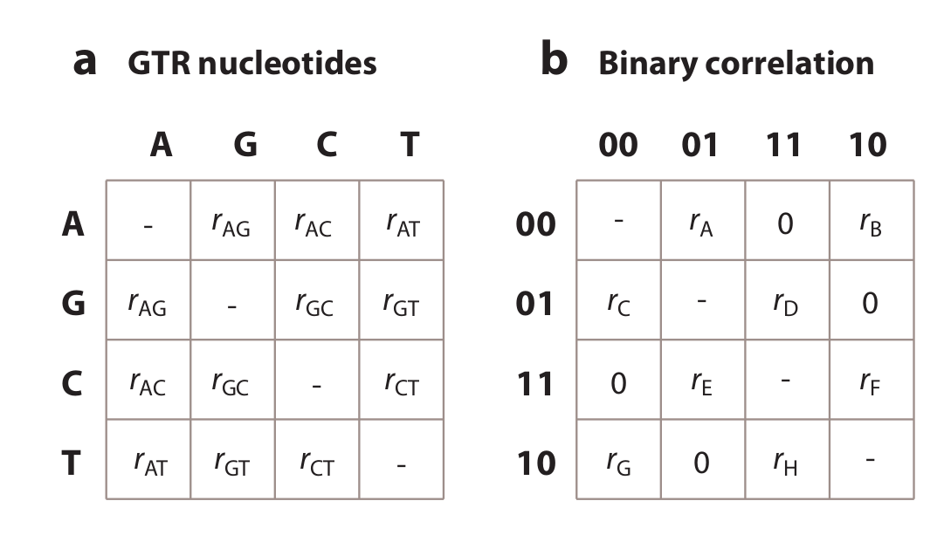
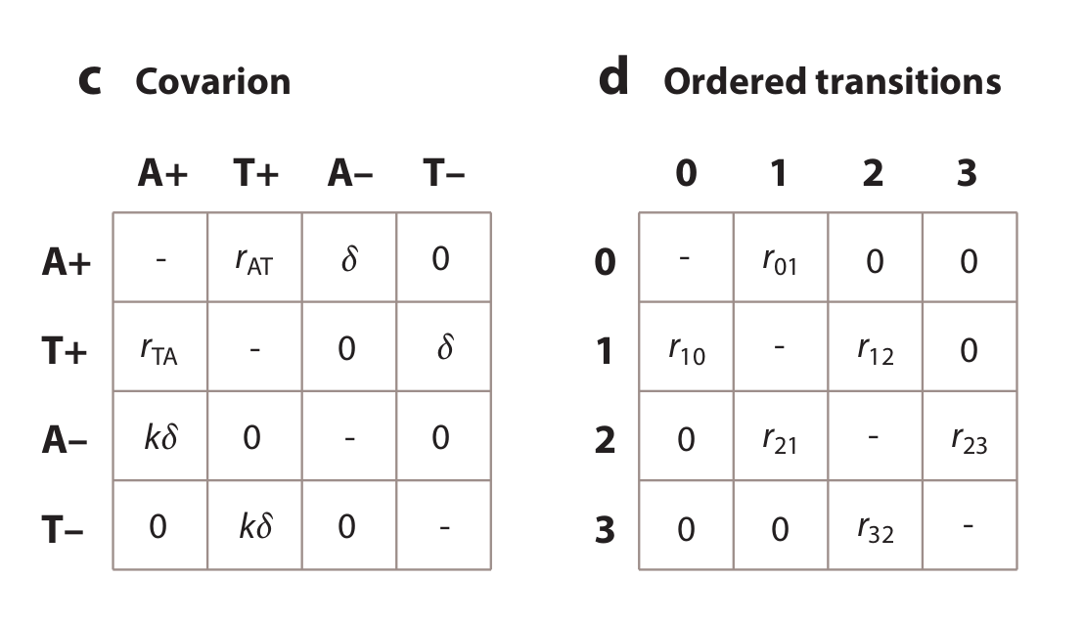
How many parameters for each? What do the models suggest about evolution?

Slide 7
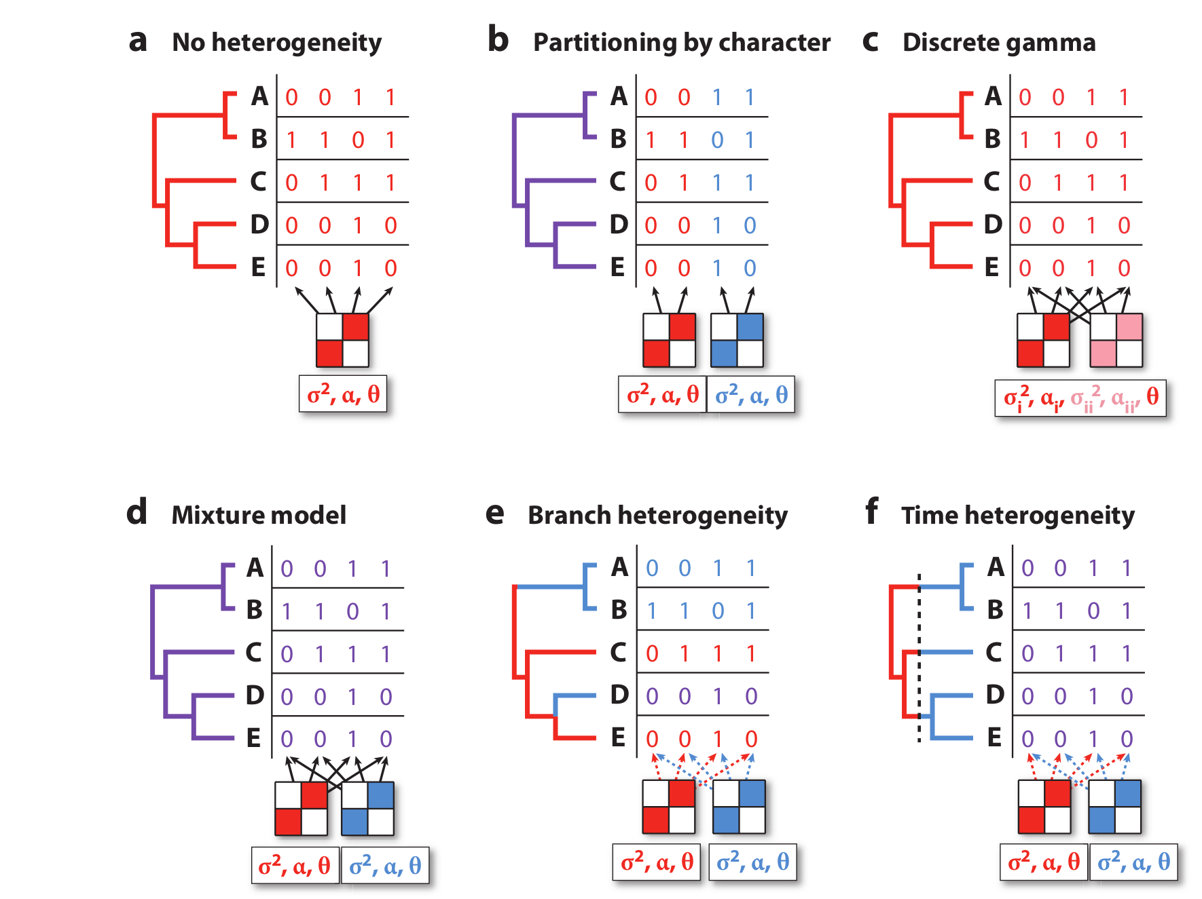
Dealing with among-site and time-heterogeneity

Slide 8


Slide 9
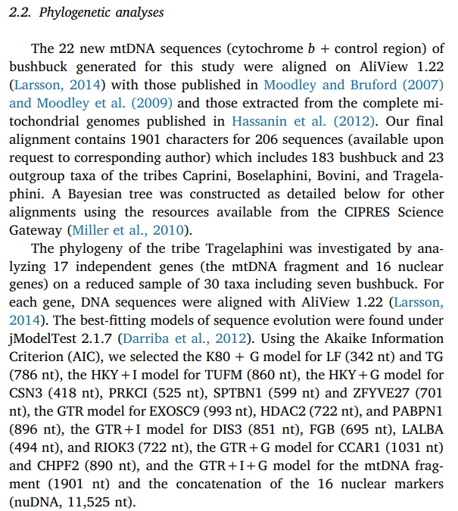

Slide 10
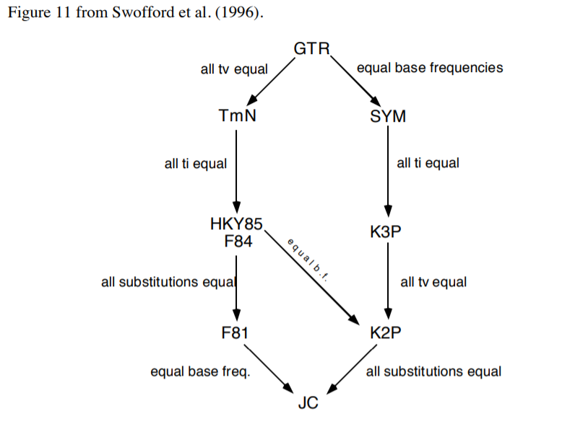

Slide 11
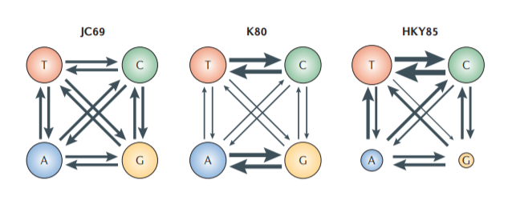
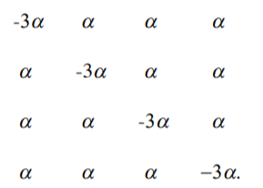
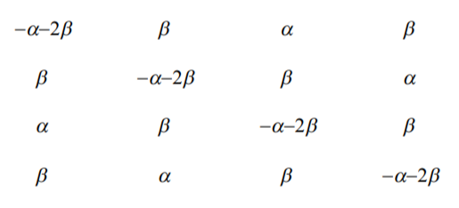
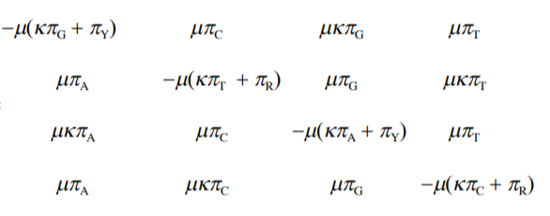

Slide 12
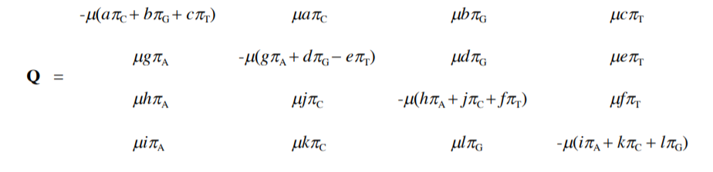
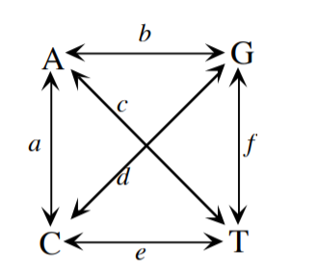
General Time-Reversible Model

Slide 13
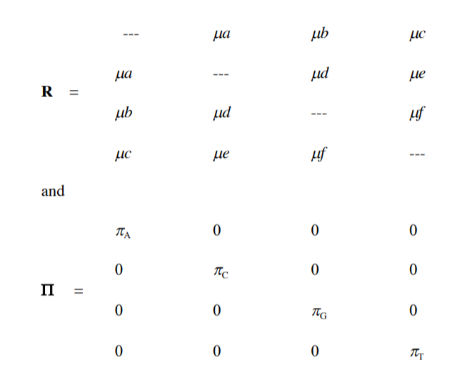
General Time-Reversible Model

Slide 14
Among-site rate variation

Slide 15
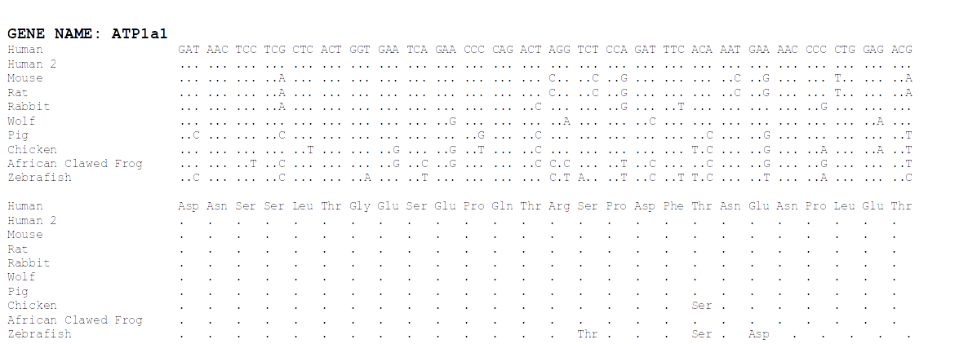
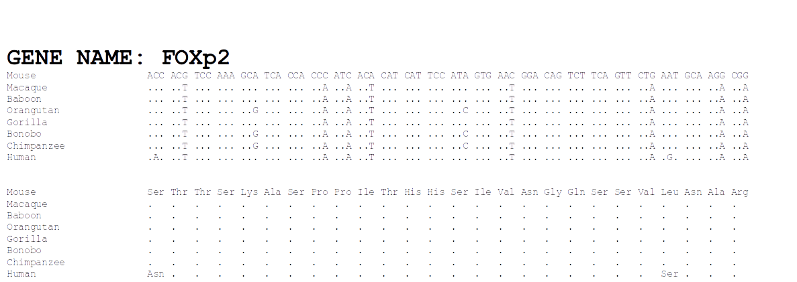

Slide 16
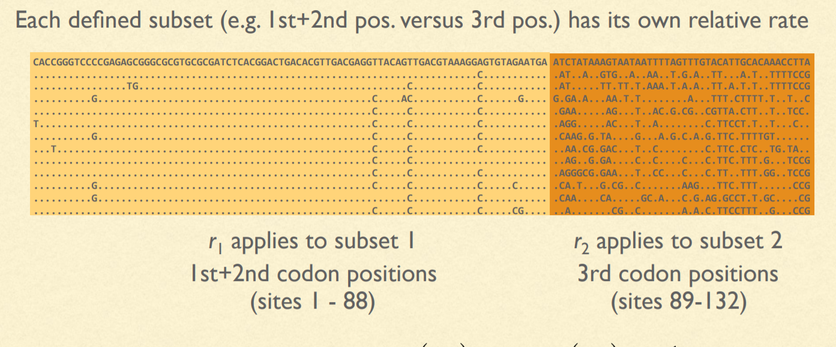
Site-specific rates

Slide 17
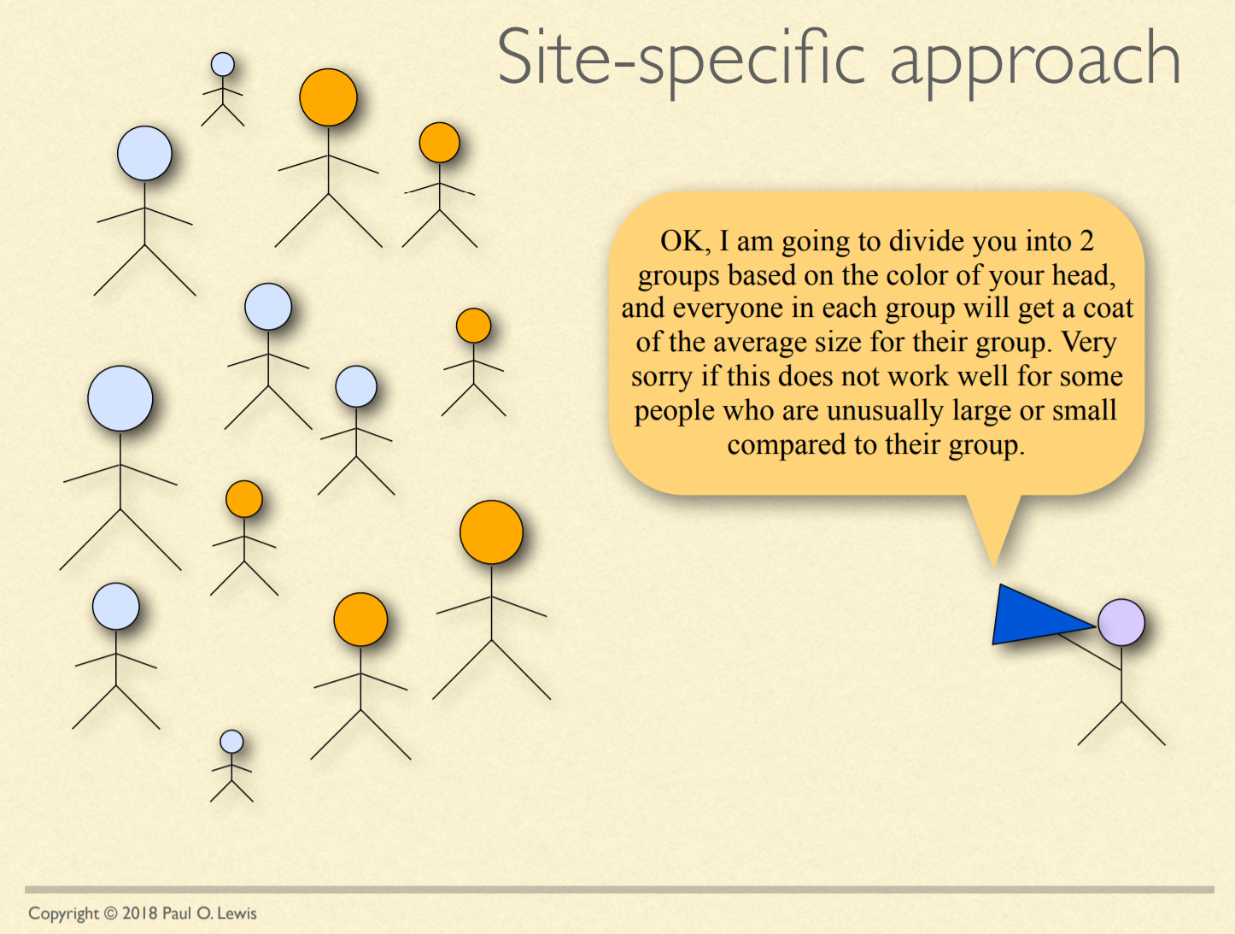

Slide 18


Slide 19


Slide 20
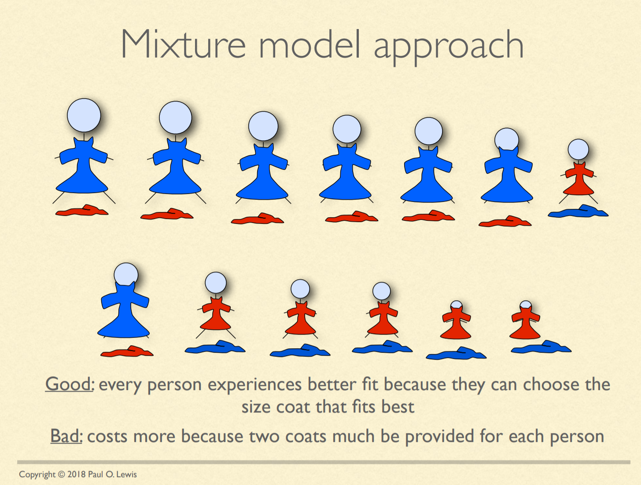

Slide 21
Invariable sites model
Every site has a probability, P_{invar} of being invariant
P_{invar} estimated from the data
Every site gets its likelihood estimated in two parts: If it were invariant & variable (as normal)
Often designated "+I" (e.g. HKY85 + I)

Slide 22
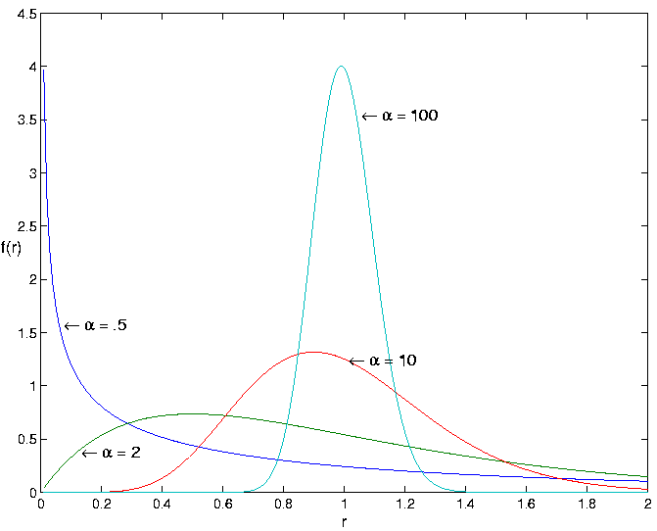
Gamma-distributed rates
Rate categories set by a discrete gamma distribution (e.g. 4 rate categories)
Estimate α
Site likelihoods calculated for each rate category and summed
"+G"
(e.g. HKY85 + I + G)

Slide 23
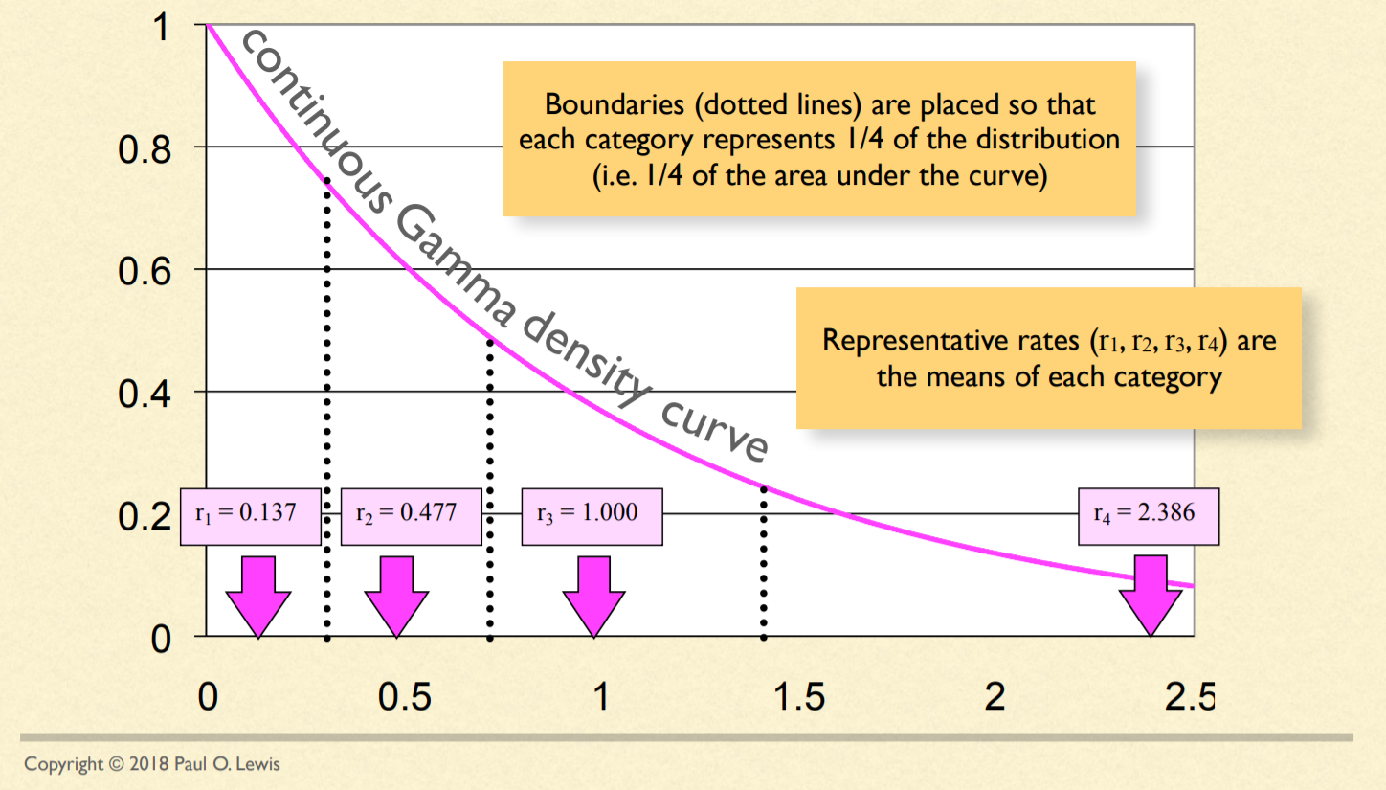
Discretizing the Gamma distribution

Slide 24
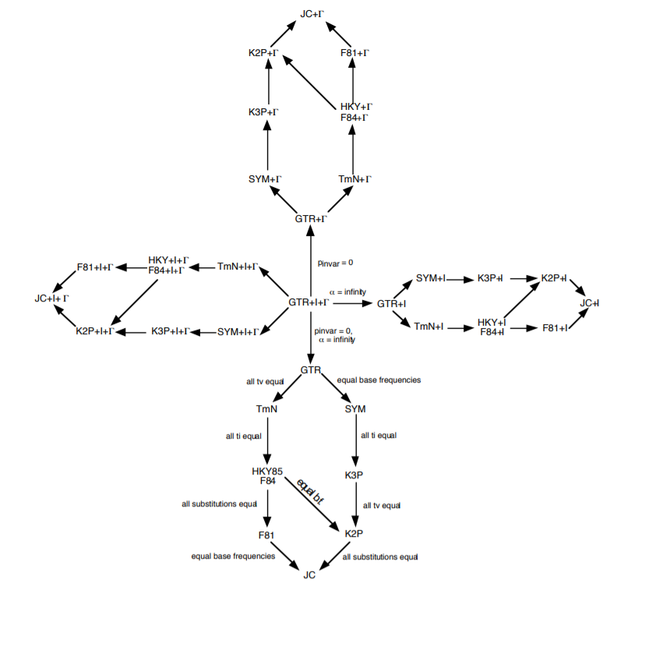
OK...but how do we decide which model to use?!?!

Slide 25
Model testing
Ideally, fit all models while simultaneously estimating tree
More practical:
Start with a not-too-bad tree, fit all the possible models, rank them by some criterion, pick the best one and use in a full analysis
Criteria: Likelihood ratio test, Akaike Information Criterion, Bayesian Information Criterion, Decision Theory, Bayesian model selection, Bayesian hypothesis testing or model averaging

